Slide 1
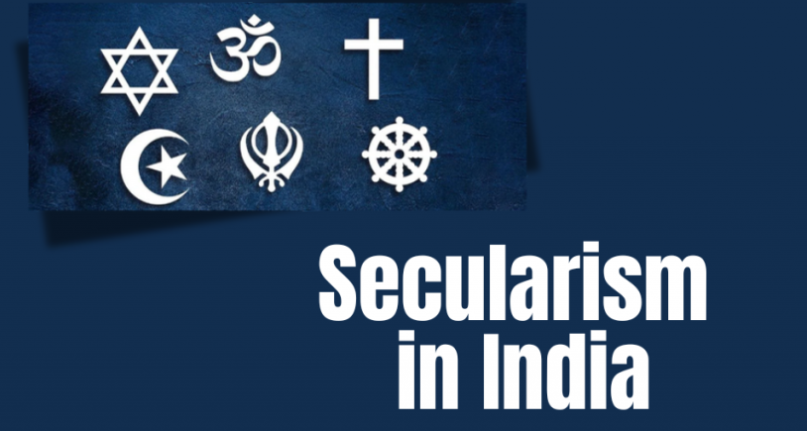
By Kangkana Sharma
Assistant Professor
Deptt. of Political Science
Dhing College

Slide 2
Secularism: the concept
Secularism in India refers to the principle of maintaining religious neutrality by the state while ensuring equal treatment of all religions. Its significance lies in fostering unity, preserving the nation’s diverse cultural fabric, and safeguarding democratic principles in a multi-religious society.

Slide 3
Secularism in india:
Equal Respect for All Religions: Unlike Western secularism, which strictly separates religion and state, Indian secularism allows the state to engage with religious groups to ensure harmony and equality.
Freedom of Religion: Citizens are free to follow, change, or reject any religion.
State Neutrality: The state does not officially endorse any religion but intervenes when necessary to ensure justice and equality.
Interventionist Role: The state has the power to regulate or reform religious practices if they violate fundamental rights, such as the abolition of untouchability and child marriage.

Slide 4
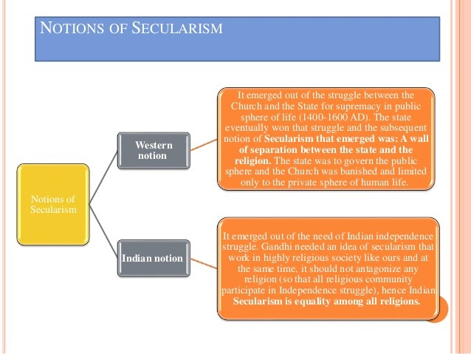

Slide 5
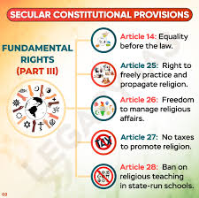
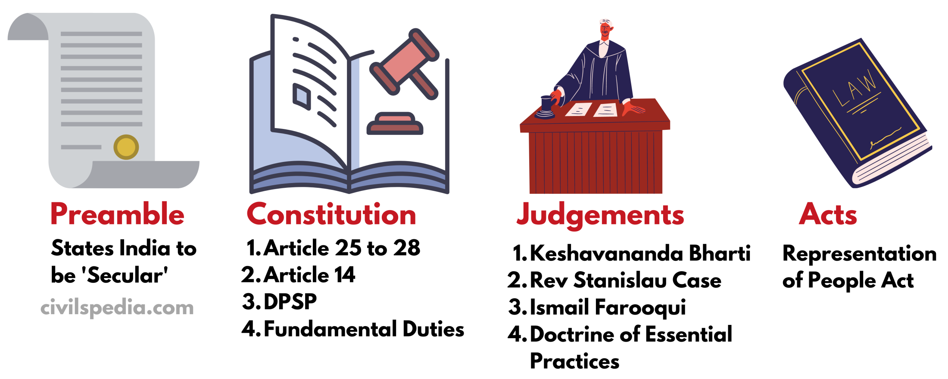
Various Sources of the concept:

Slide 6
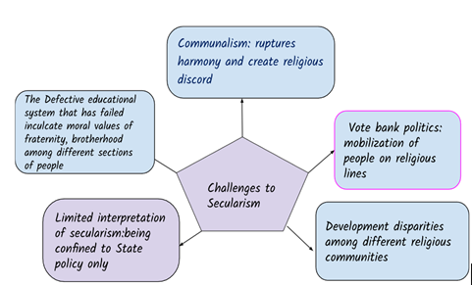

Slide 7
Conclusion:
Secularism in India is not merely a constitutional mandate but a social necessity, given the nation’s rich diversity. While challenges persist, the enduring commitment to secular values by the Indian state and its citizens reflects the strength of this principle. By addressing contemporary challenges through inclusive policies and fostering a culture of mutual respect, India can preserve its unique model of secularism, ensuring unity in diversity for generations to come.

Slide 8
Thank you

